Slide 1
Intro to Programming I: Intro to Python
June 20th, 2024

Slide 2

Motivation
Computer Programming: Creating a schedule of events for a computer to follow to complete a task.
Why learn programming?
To become a programmer
To think computationally
To apply computational tools to problems
Notes:
Briefly define programming
Motivation: Why learn programming?
to be a programmer
to apply computational tools to problems
to think computationally

Slide 3
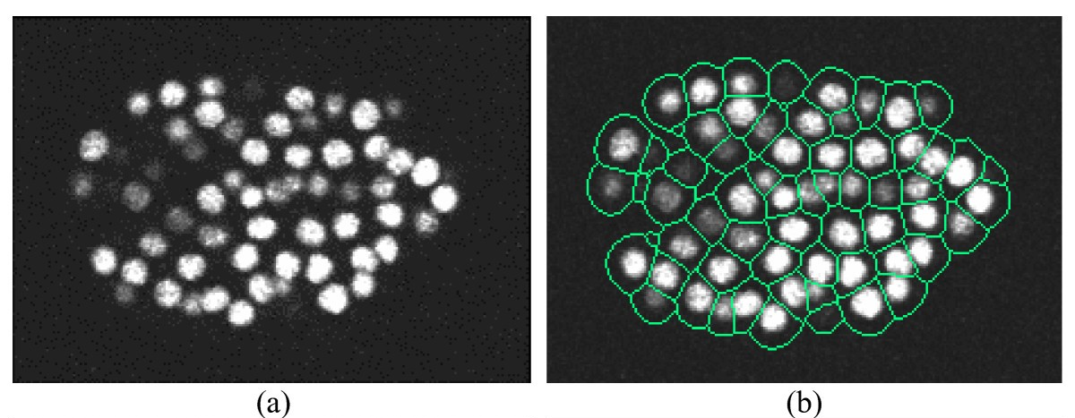
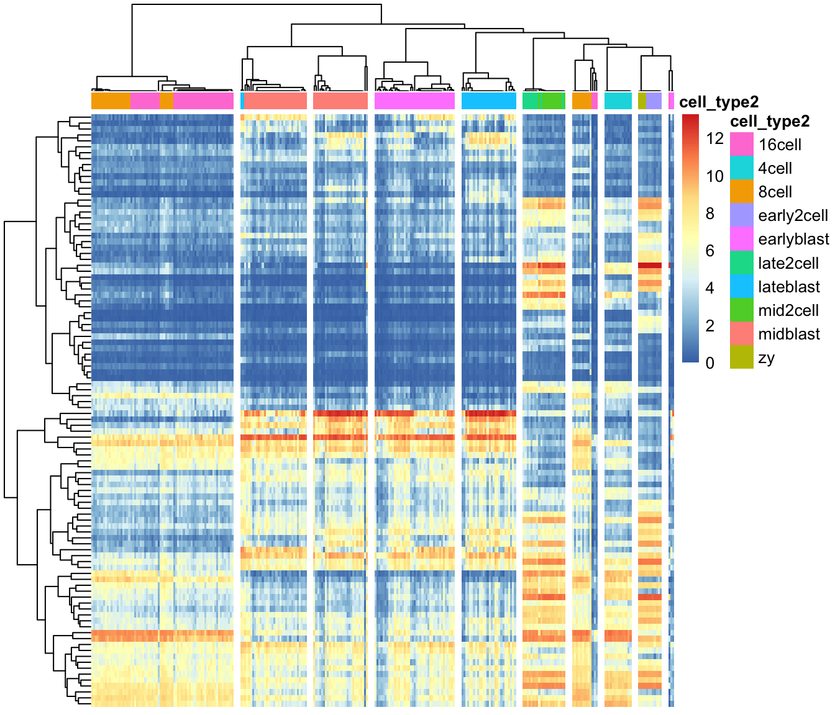
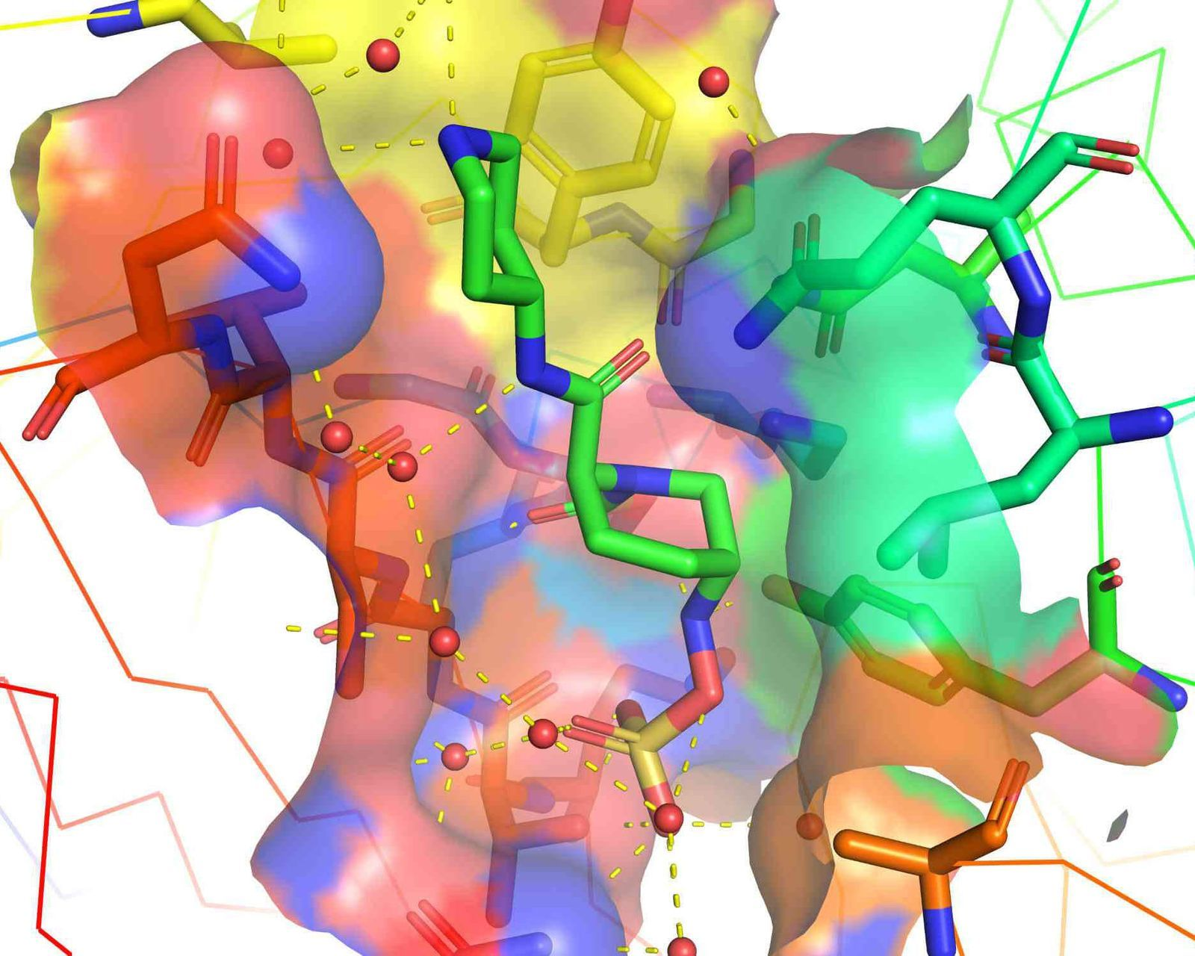

Motivation
What do you use programming for?
Notes:
Applications (and also, a bit of a course roadmap)
Plotting, data exploration, DNA/RNA sequencing data
Large-scale image processing
Simulations, machine learning, etc.

Slide 4
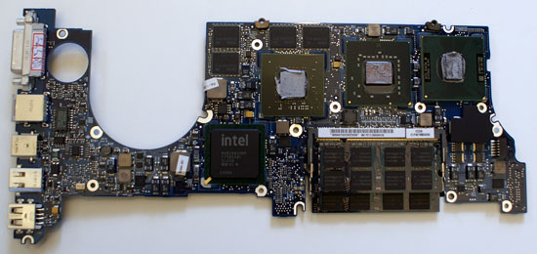

Python is a language
“01011110010101001010010010101
010101001110110010101111001010
101010100110010011011010010101
101010100101001010100101001001”
“Calculate the energy
of a protein in this
conformation.”
Notes:
A language…
…read by an interpreter…
…to create an output.
http://www.openbookproject.net/thinkcs/python/english3e/
https://docs.python.org/3/tutorial/

Slide 5
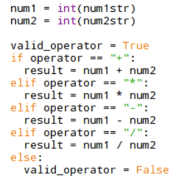
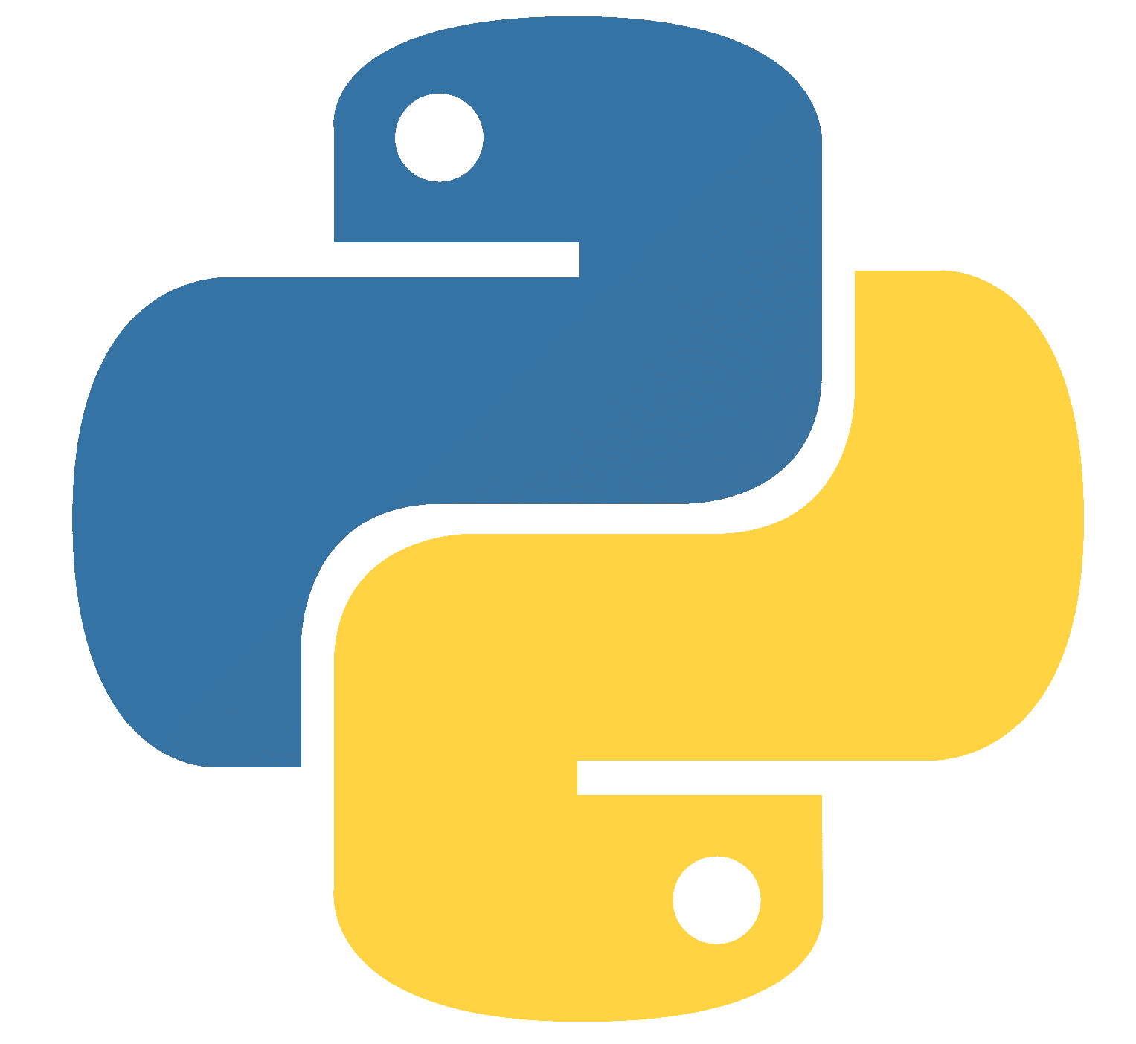

Python is a language
“Calculate the energy of a protein in this
conformation.”
“01011110010101001010010010101
010101001110110010101111001010
101010100110010011011010010101
101010100101001010100101001001”
(You are here)
Human Language > Programmer > Python > Python Interpreter > Machine Language
+ easy to pick up
- slower than other languages
Notes:
A language…
…read by an interpreter…
…to create an output.
Python --> programming language
then discuss different possible languages, pros and cons of python.
http://www.openbookproject.net/thinkcs/python/english3e/
https://docs.python.org/3/tutorial/

Slide 6
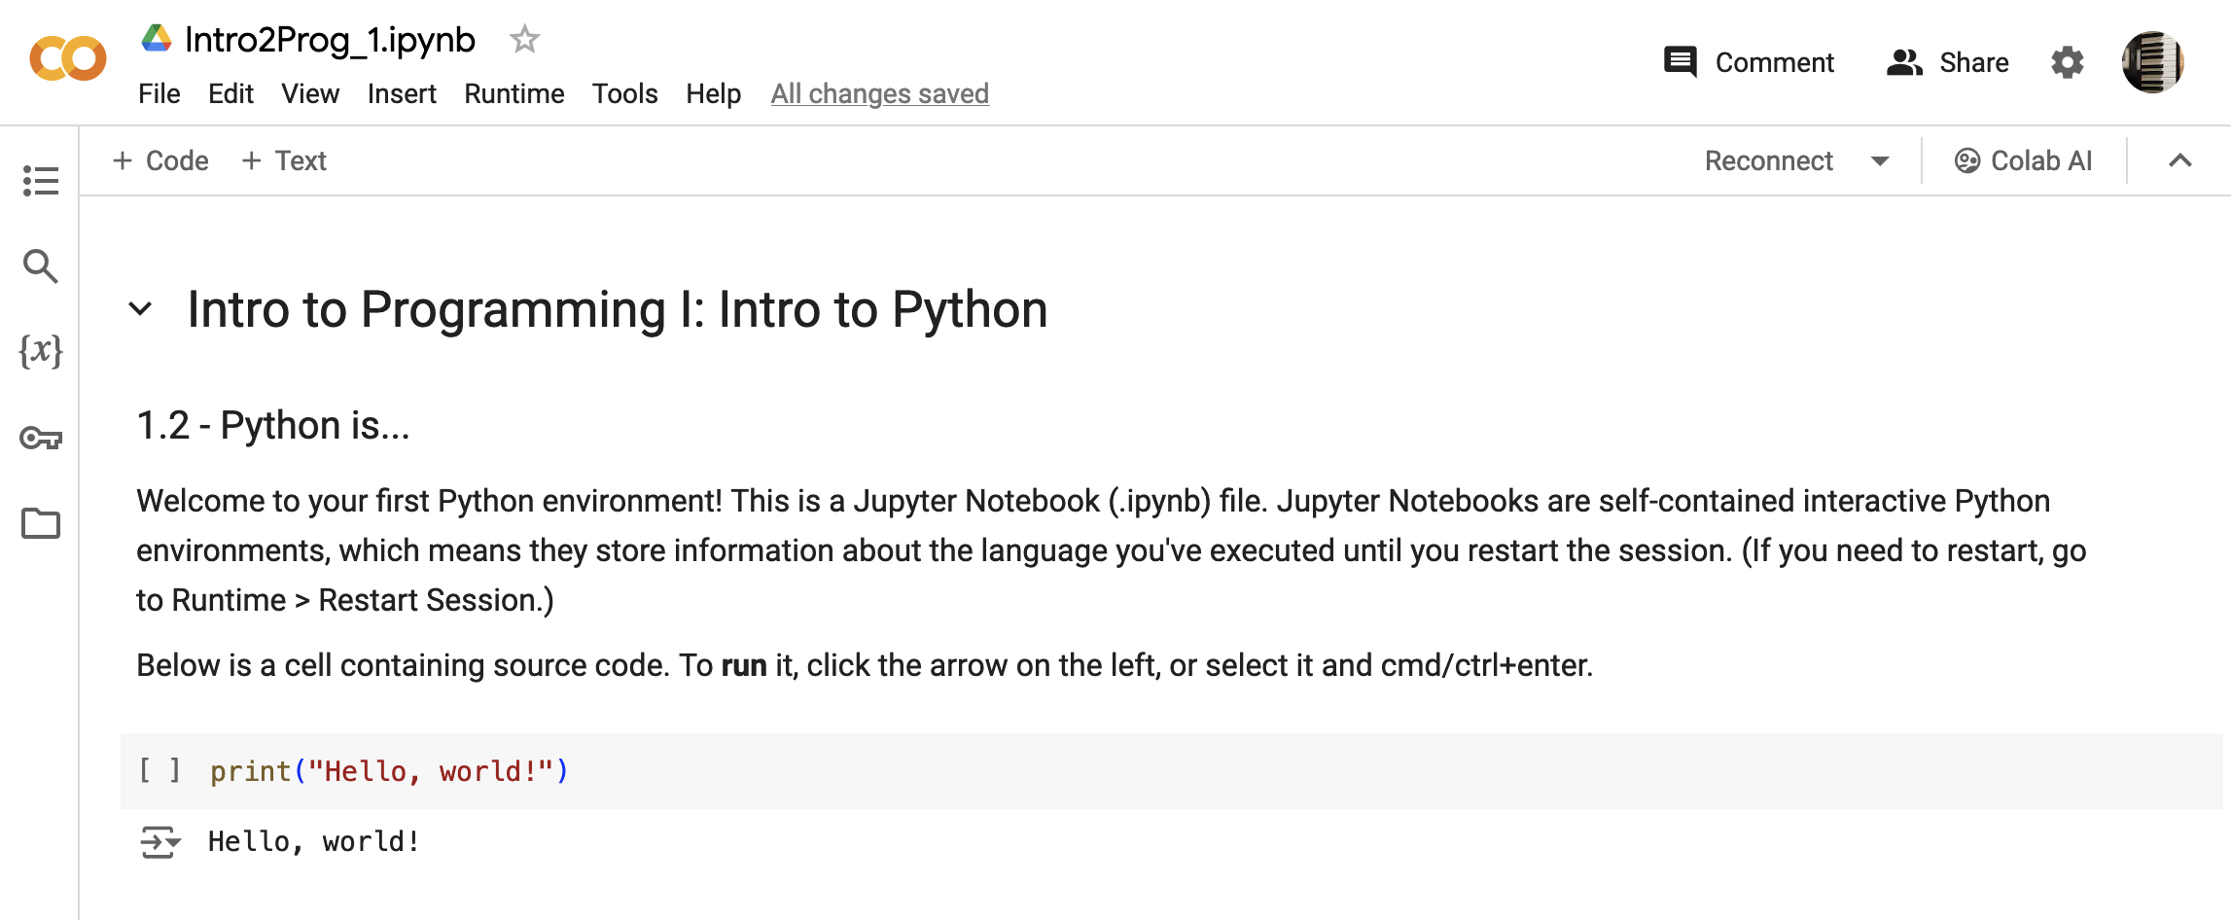
Let’s try Python!
Colab link

Slide 7
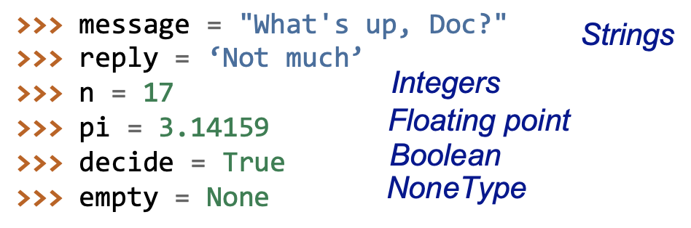
Variables
Now we can fix our bug!

Slide 8
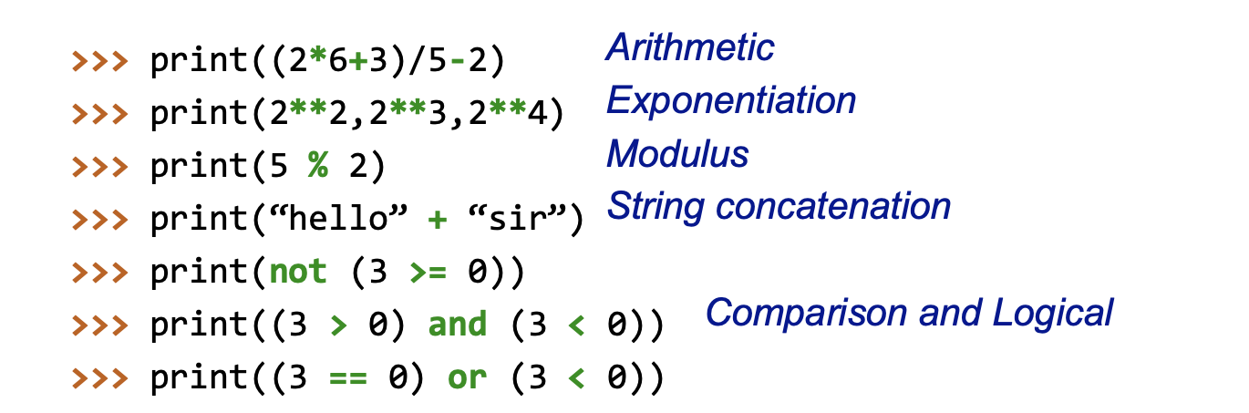
Operators
Notes:
This is too much information, show these things 1 by 1
Show math notation (Latec), then show the python version
1 slide and 1 CoLab cell per new operation
Variable type --> Operation on variable
PEMDAS
string addition + multiplication
Booleans --> Logical statements --> "show the logic table"
==

Slide 9
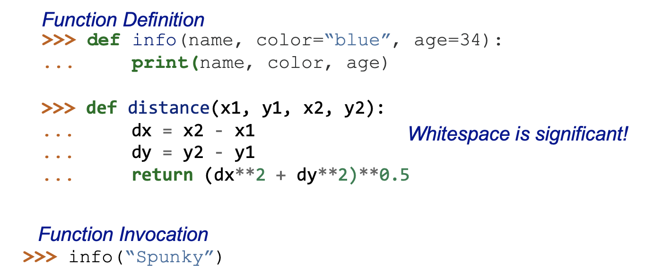
Functions
Can you predict what this line of code will do?
Notes:
start with a simpler function
def function_name():
print("The function just ran!")

Slide 10
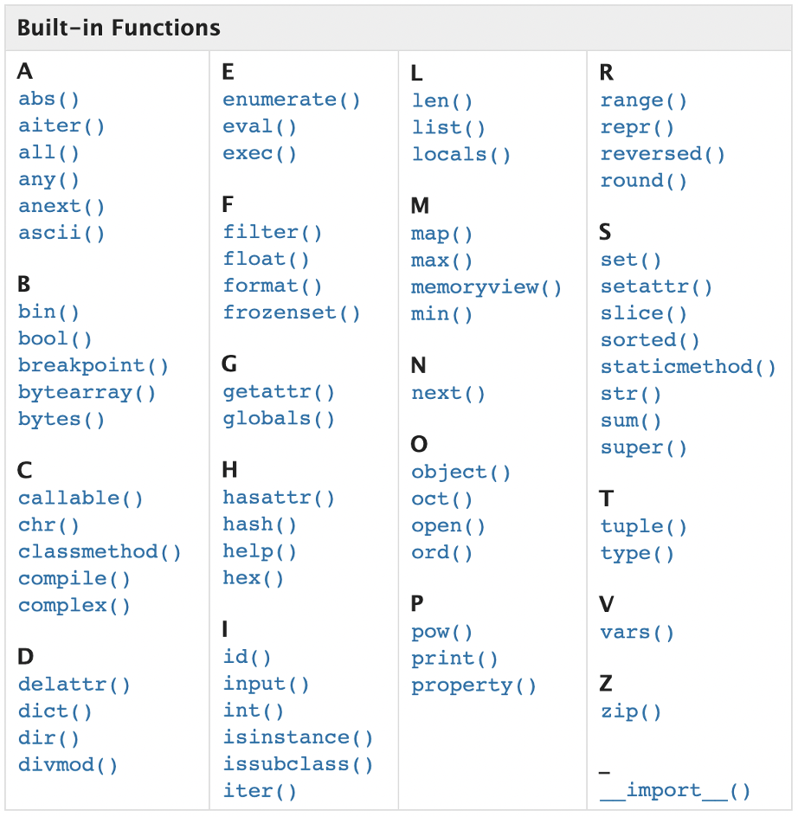
In-Built Functions

Slide 11
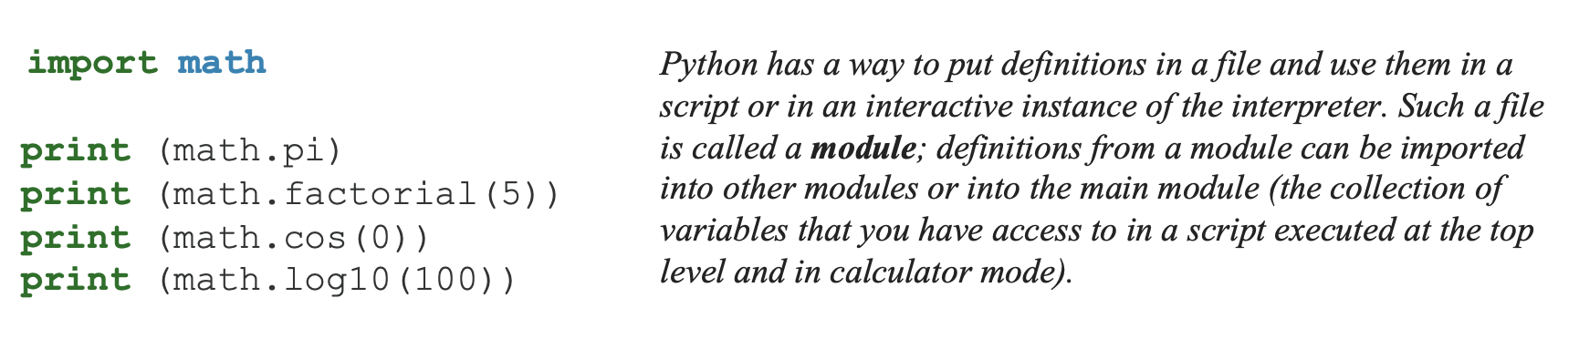
Modules
Notes:
import math
if you just want one thing:
from math import pi
get the cosin function and use it:

Slide 12
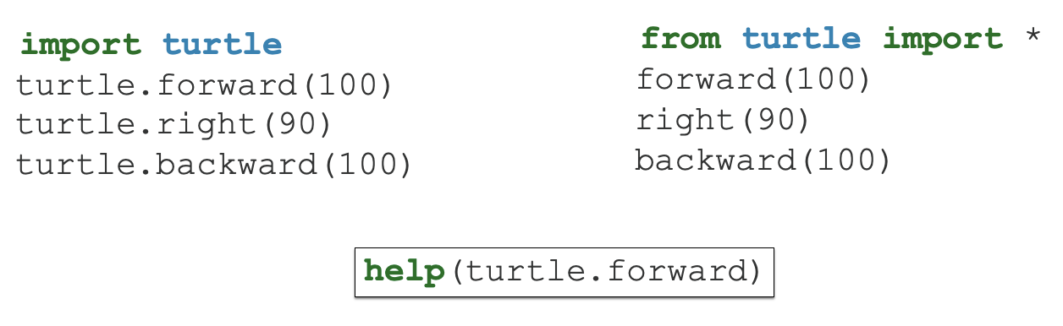
Turtles!!!
Back to colab!
Notes:
from time import sleep to make the turtle go slower

Slide 13
Intro to Programming II: Dataframes & Sequencing

Slide 14
Learning Objectives
RNA sequencing data

Slide 15
Learning Objectives
RNA sequencing data
Understand conditional statements
Understand a common scientific data type: dataframes
Work with and plot real RNA sequencing data

Slide 16
Colab link

Slide 17
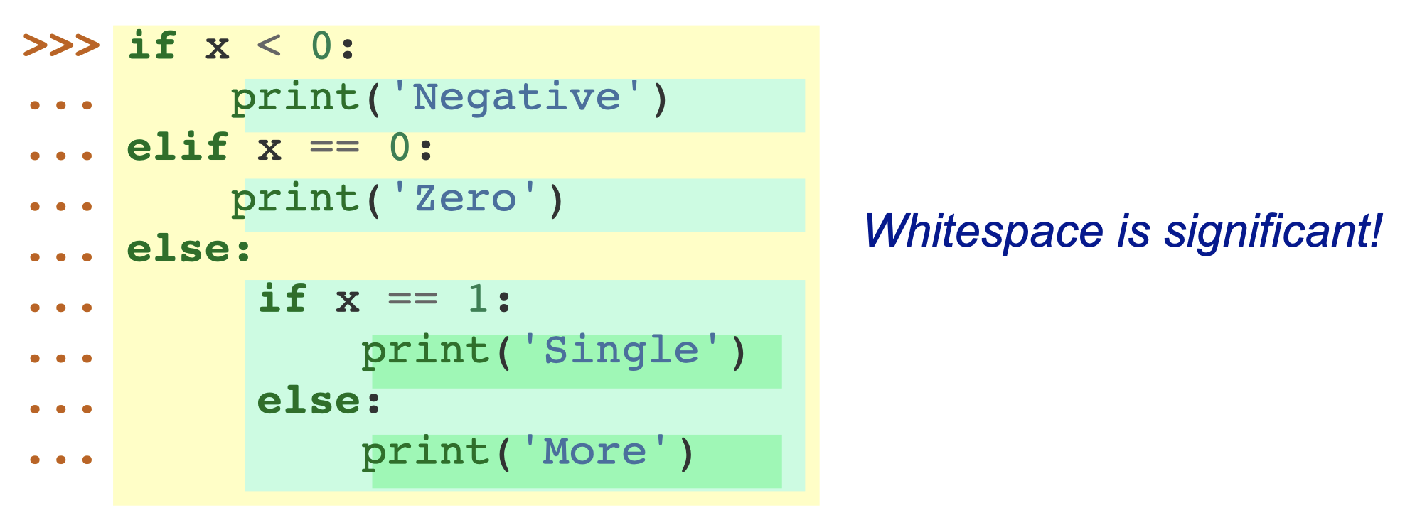
Conditionals

Slide 18
Filtering
Filtering dataframes works like a series of if statements: check each row → calculate Boolean → if True/elif False

Slide 19
Filtering
Use conditionals to filter outliers from data
Use conditionals to label certain elements of data
Volcano plot
Use function definition for filtering
For plotting multiple samples

Slide 20
Pandas Dataframes
Kaggle dataset
Introduce dataset → dataset exploration
Plot data in Co-Lab
New Module: pyplot
How do we refine our plot?

Slide 21
RNA Sequencing
Kaggle dataset
Introduce dataset
Plot data in Co-Lab
New Module: pyplot
How do we refine our plot?

